Slide 1
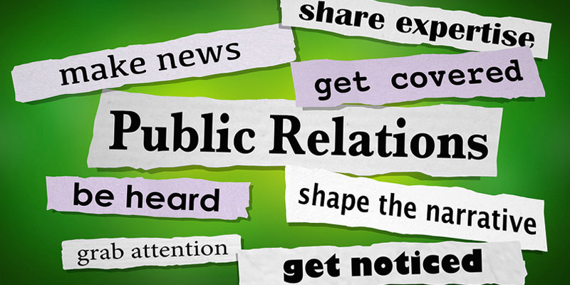

Slide 2
Notes:
key word here is relationships.
Besides the media, who would you want to build relationships with?
Answer:
members
donors
public

Slide 3
Notes:
- Who are your Internal Publics at your post?
- What about your External Publics?

Slide 4
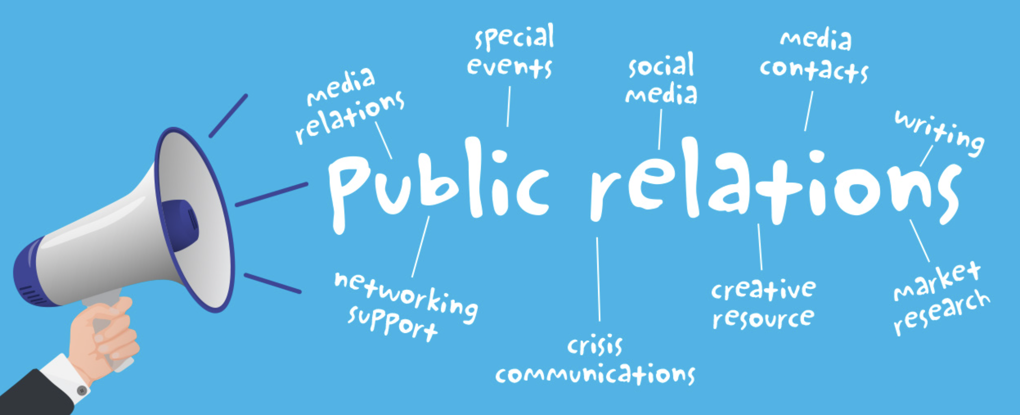
Notes:
To further define public relations… Here are some things that may relate to the work you do at your post or district.

Slide 5
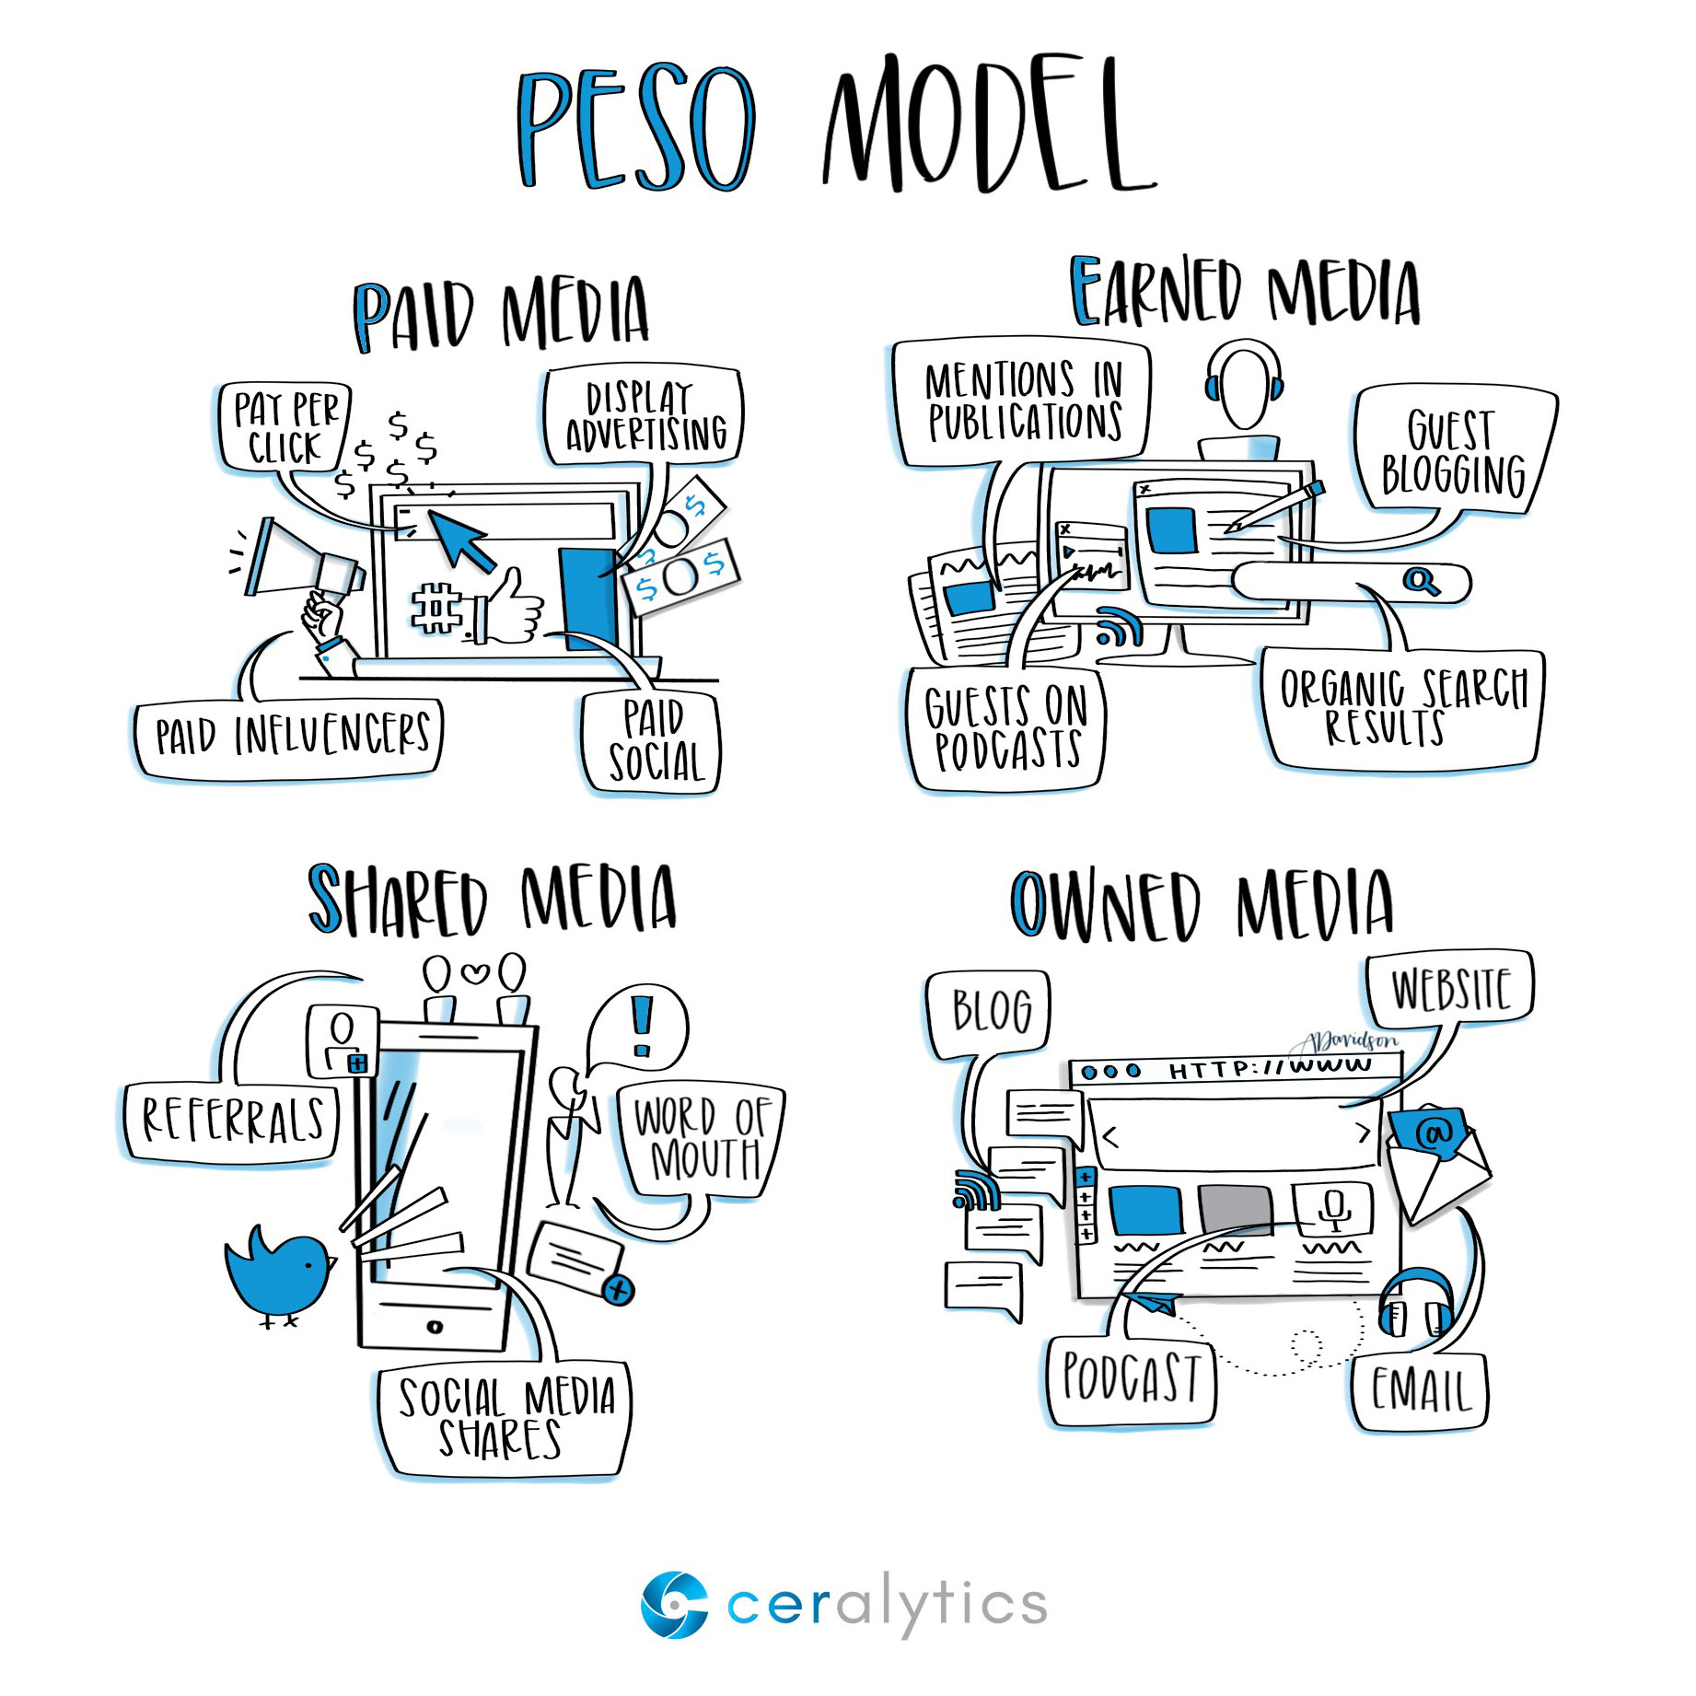
Notes:
Take note of some of the outreach at your disposal:
Paid – Advertising
Earned – News coverage
Shared – Social media
Owned – Website

Slide 6
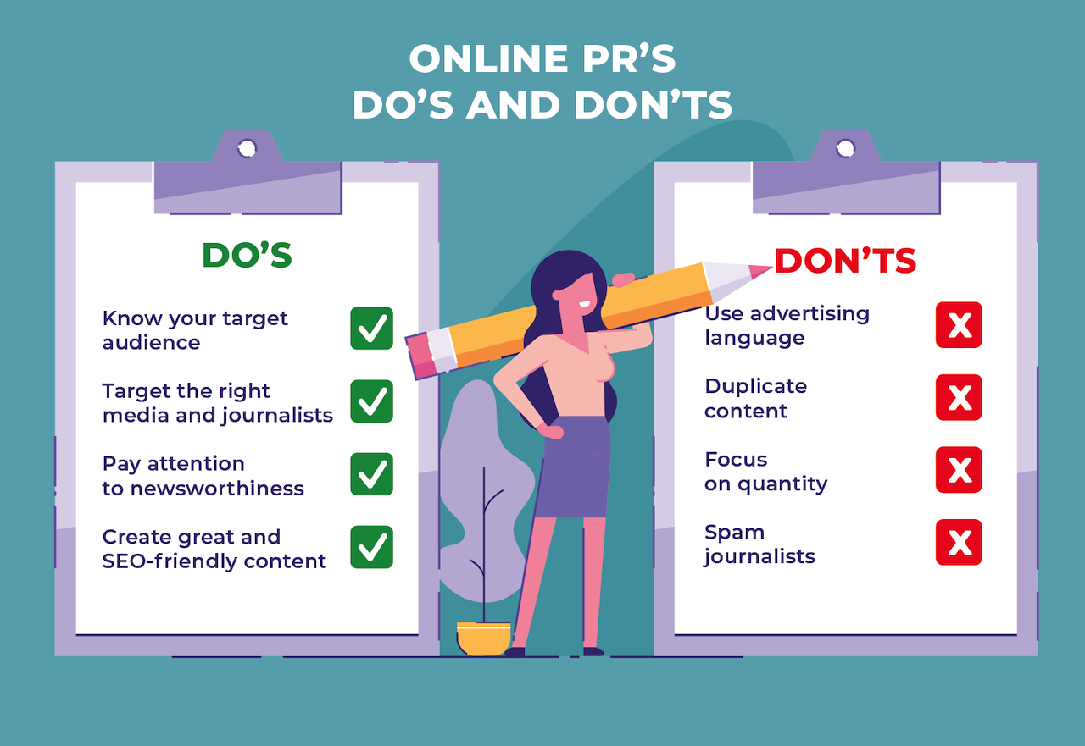
Notes:
Pay attention to newsworthiness

Slide 7
Notes:
1) Impact
People want to know how a story is going to affect them. What consequences will be suffered if they don’t take action on your issue? How can they improve their lives by buying your product or service?
2) Timeliness
It’s called news for a reason—because it’s new information. The more recent your information, the more likely people will find it of interest. In today’s age of internet immediacy, this is even truer than it used to be.
3) Proximity
Although the internet is breaking this one down, to some degree, but we are still more likely to care about something down the street than across the world.
4) Human Interest
This is one of the most broad categories, and also one of my favorite. These are stories that show something about the human condition. From rags to riches stories, experiential pieces and the like are things that make us feel very strong emotions, they make us smile or laugh, derive purpose and meaning or want to help others.
5) Conflict
Fight! Fight! Fight! It’s in our nature to gravitate toward conflict. Just think of how much “news” comes out of every single election—A versus B is a simple conflict to report, and we always want to know who’s going to come out on top.
6) The Bizarre
Two words. Octo Mom. Anything with shock value might seem like click bait, but sure enough, we will keep on clicking!
7) Celebrity
Whenever something happens to someone important or semi-famous, we tend to care more about it because these people seem special to us, and we feel like—to some extent—we know them.

Slide 9
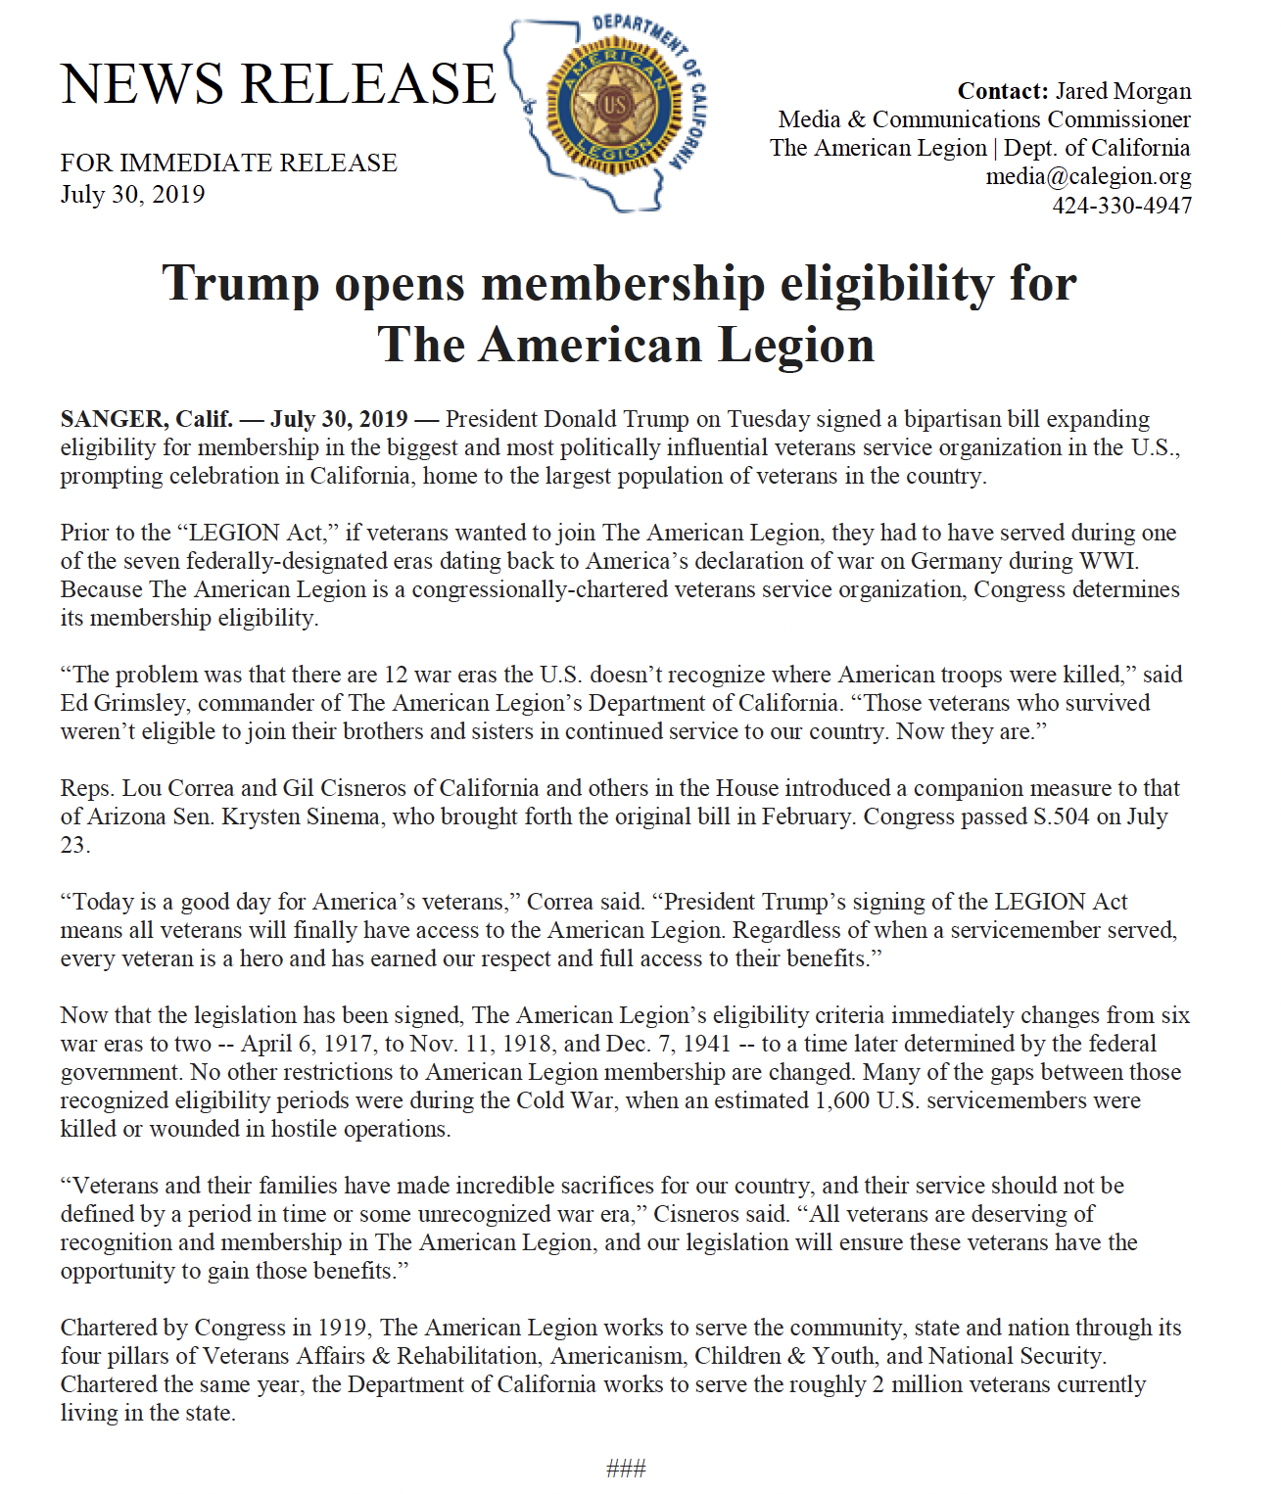
Notes:
- A headline
- a summary
- a dateline and lead
- the body text
- a quote, a boiler plate statement
and contact information for the media to reach you
Can you tie your news to a compelling personal interest story?

Slide 10
Notes:
- A headline
- a summary
- a dateline and lead
- the body text
- a quote, a boiler plate statement
and contact information for the media to reach you
Can you tie your news to a compelling personal interest story?

Slide 12
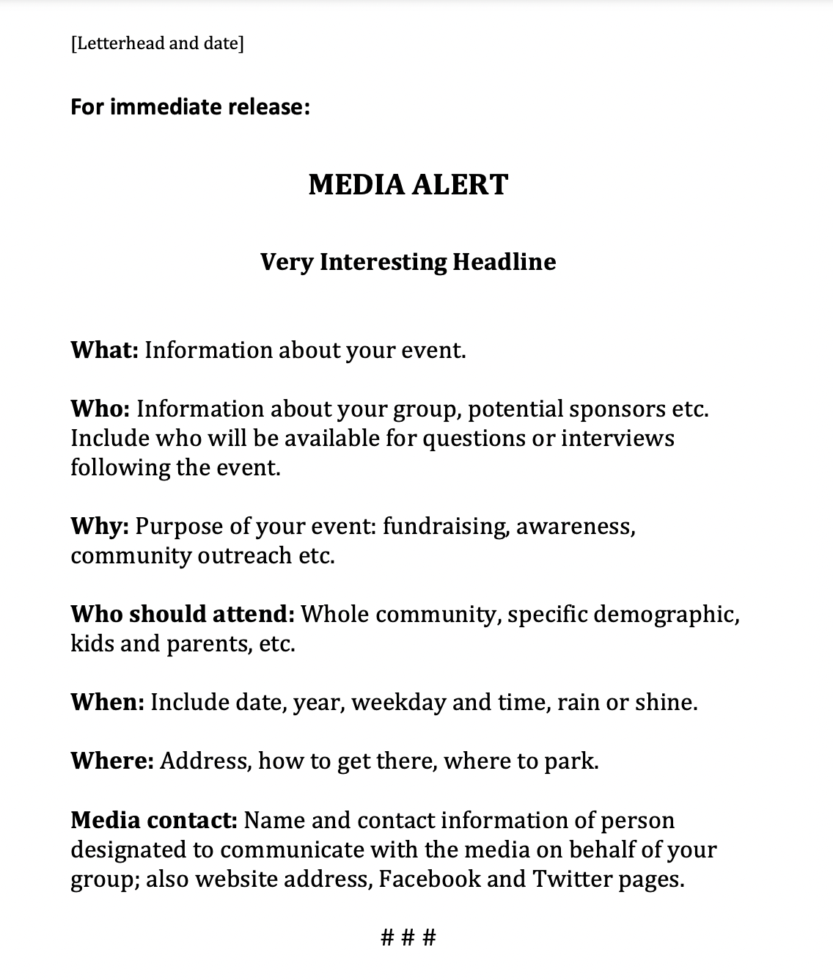
Notes:
- Media alerts are shorter, they could be in bullet points. You can use this format for simple events that don’t have deeper stories attached.

Slide 13
Notes:
Journalists write using the inverted pyramid, making sure to put the most important information at the beginning. It’s called a lead (or lede).

Slide 14
Notes:
- You’ve got your press release written and now you’re just gonna send it. But to who?

Slide 15
Notes:
Do your research — Do you have any local newspapers in your city or town? TV news stations? Radio stations? Blogs? Newspapers include names, titles and sometimes contact info in a section called the “masthead”. A simple Google search can turn up an editorial contacts page online. If all else fails, contact the ad sales or customer service department and ask for a good editorial contact to reach. Sometimes a “news tips” email or phone line will be set up. Also check Twitter to search for reporters, producers or editors who can help.

Slide 16
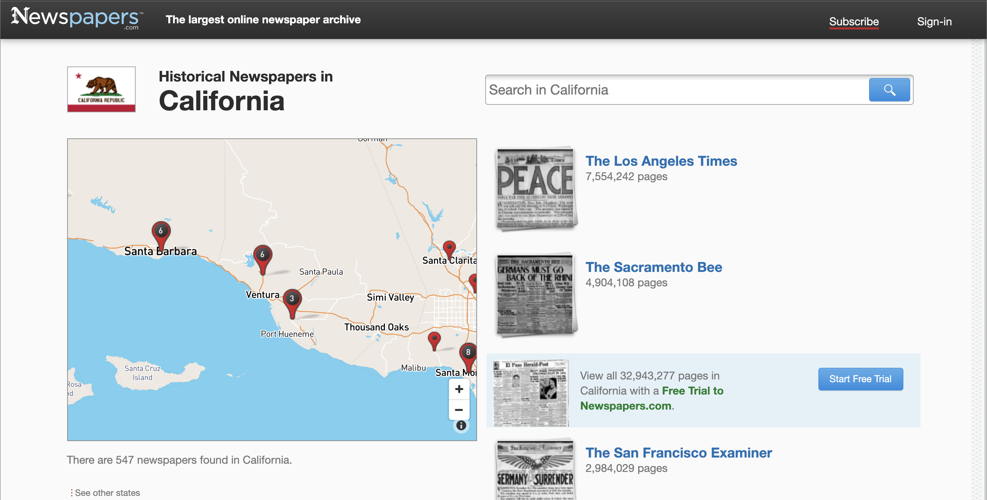
Notes:
You can use this site to find larger papers.

Slide 17
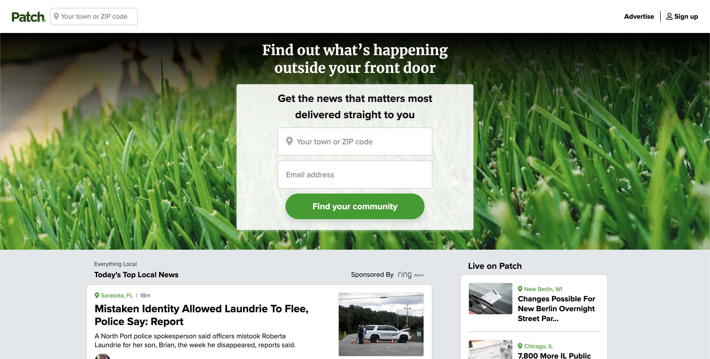
Notes:
patch.com is a great local news source. Type in your town or zip and there may be a Patch site in your area.

Slide 18
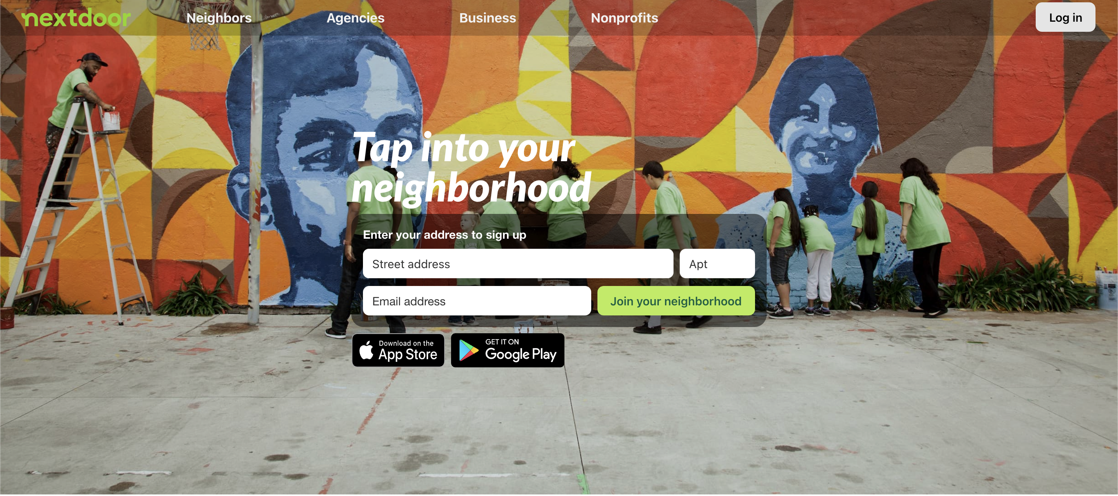
Notes:
Local reporters sometimes search sites like Nextdoor.com, so you can post news here when time permits.

Slide 20
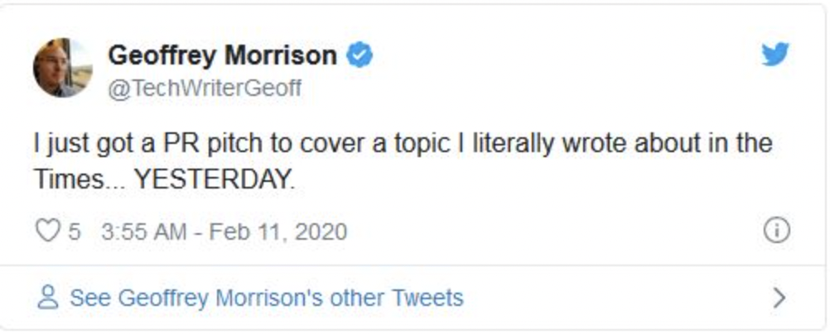
Notes:
Make sure you’re up on current events so you don’t pitch a story that’s already been covered.

Slide 21
How to Contact Reporters and Editors
1. Get straight to the point
2. Be relevant
3. Personalize your email
4. Don't get lost in the clutter – Know their deadlines
5. Stay away from attachments
6. Follow up, but avoid being pushy

Slide 22
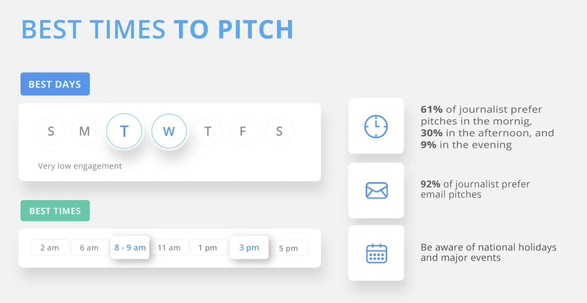
Notes:
Here’s one opinion on the best time to pitch to reporters. Make sure you ask what a publication’s deadlines are so you don’t pitch on the wrong day.

Slide 23
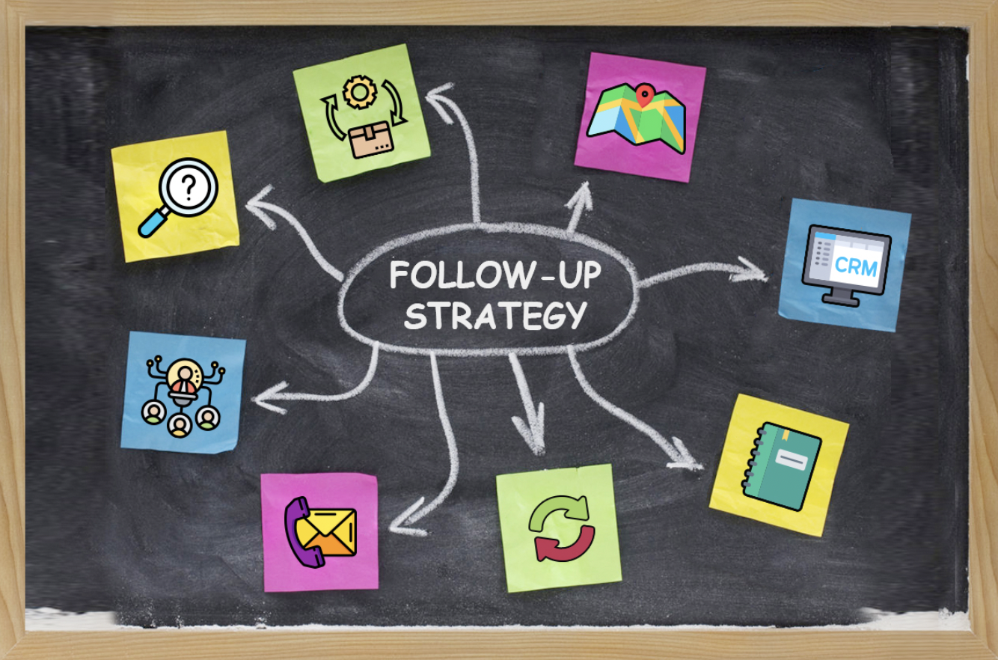
Notes:
- Have a good follow up strategy.
Once a week, have an update with new information each time
How to reach a journalist:
Email
Social media (Twitter is great)
Text message
Phone call (not preferred)

Slide 24
Any questions?
Email Jared Morgan (editor@caLegion.org)

