Slide 1
Department Convention
District Secretary Training
Presented by Diane DeVries
Credentials Committee member

Slide 2
DISTRICT SECRETARY RESPONSIBILITIES
You were submitted as District Secretary by your District
Accurately log in delegates/alternates and Delegates-in-their-own- Right
Issue delegate badges
Calculate your District’s delegate strength as registered (voting strength)

Slide 3
DISTRICT SECRETARY RESPONSIBILITIES
Assist any Posts within your District with delinquent reports/fees (if possible)
Help is also available in room San Joaquin Ballroom A (HQ Office)
  Credentials Committee
  HQ Staff

Slide 4
DISTRICT SECRETARIES
How to check someone in as a Delegate/Alternate
Including a Delegate-in-their-Own-Right

Slide 5
DISTRICT SECRETARIES
Registration Folders and delegate/alternate badges will be picked up from Department HQ at the opening of each day (Thursday – Saturday 9 am) and turned in at the close of each day (TBD). You may also pick up a limited amount of “goodie bags”.
Registration Secretaries MUST be open for registration at the times set. If taking a break, have someone fill in for you (or post a sign).
Folders are to stay at the Registration Desk at all times or turned into the Headquarter Office located in San Joaquin Ballroom A (Dana).
DO NOT TAKE THE FOLDERS OUT OF THE REGISTRATION AREA

Slide 6
DISTRICT SECRETARIES
  No delegate or alternate from any Post shall be accredited in the Department Convention unless:
    CPR
    Certification of Officers
    Certification of Delegates
    Delegate fees paid
    Annual Post Data report
    Audit (past due – 2025 and prior)
    Current Constitution & Bylaws
See Administrative Compliance Report

Slide 7
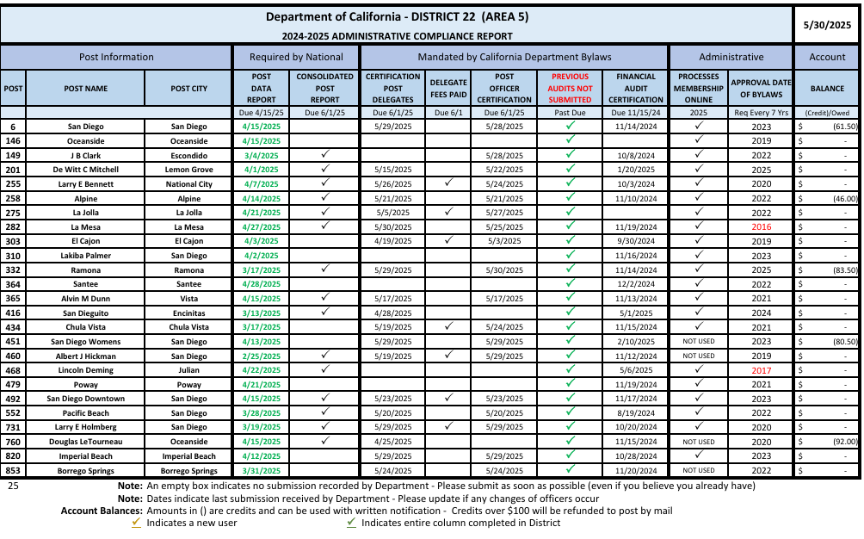

Slide 8
DISTRICT SECRETARIES
Registration Secretaries are to make NO MARKS on the Administrative Compliance Report.
  Credentials Committee Members must be able to check clearance slips against the sheet.
Registration Secretaries shall list on the Registration Work Sheet
  posts as they check in
  number of Delegates per post
  Delegates in-their-own-right

Slide 9
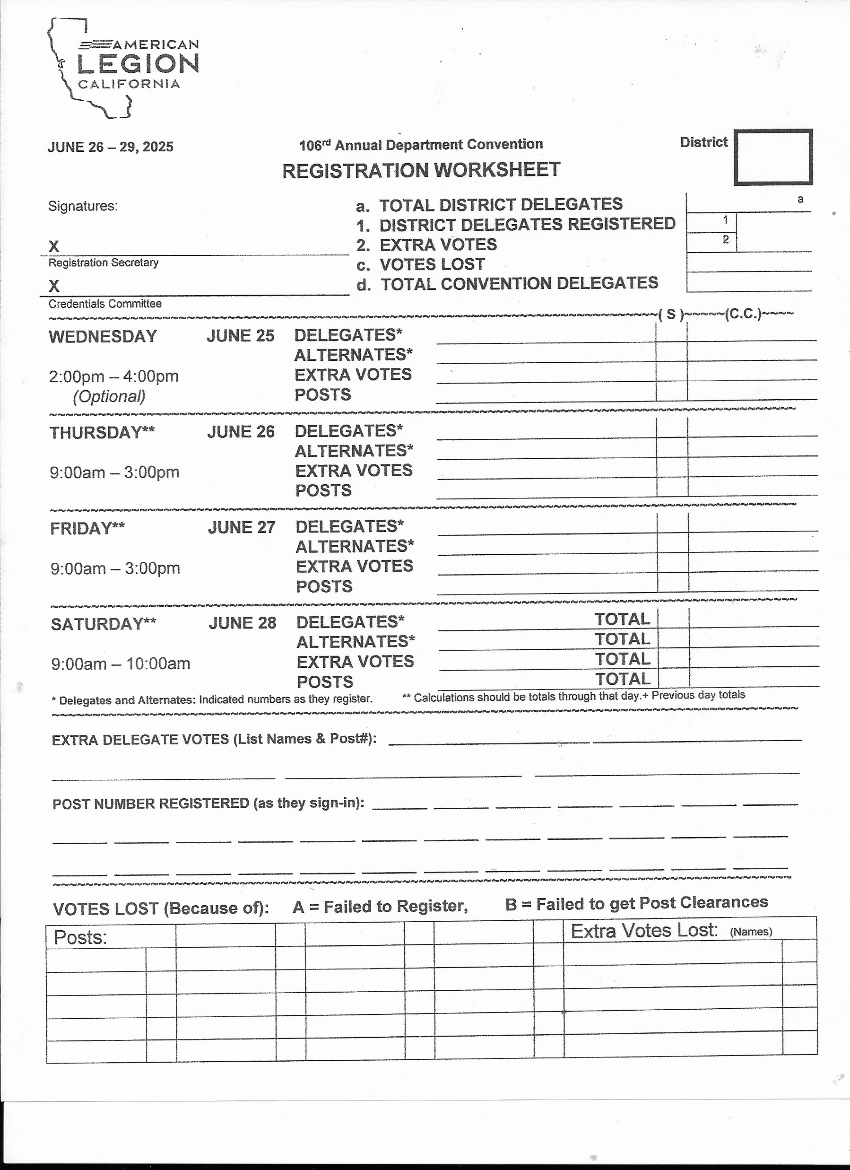

Slide 10
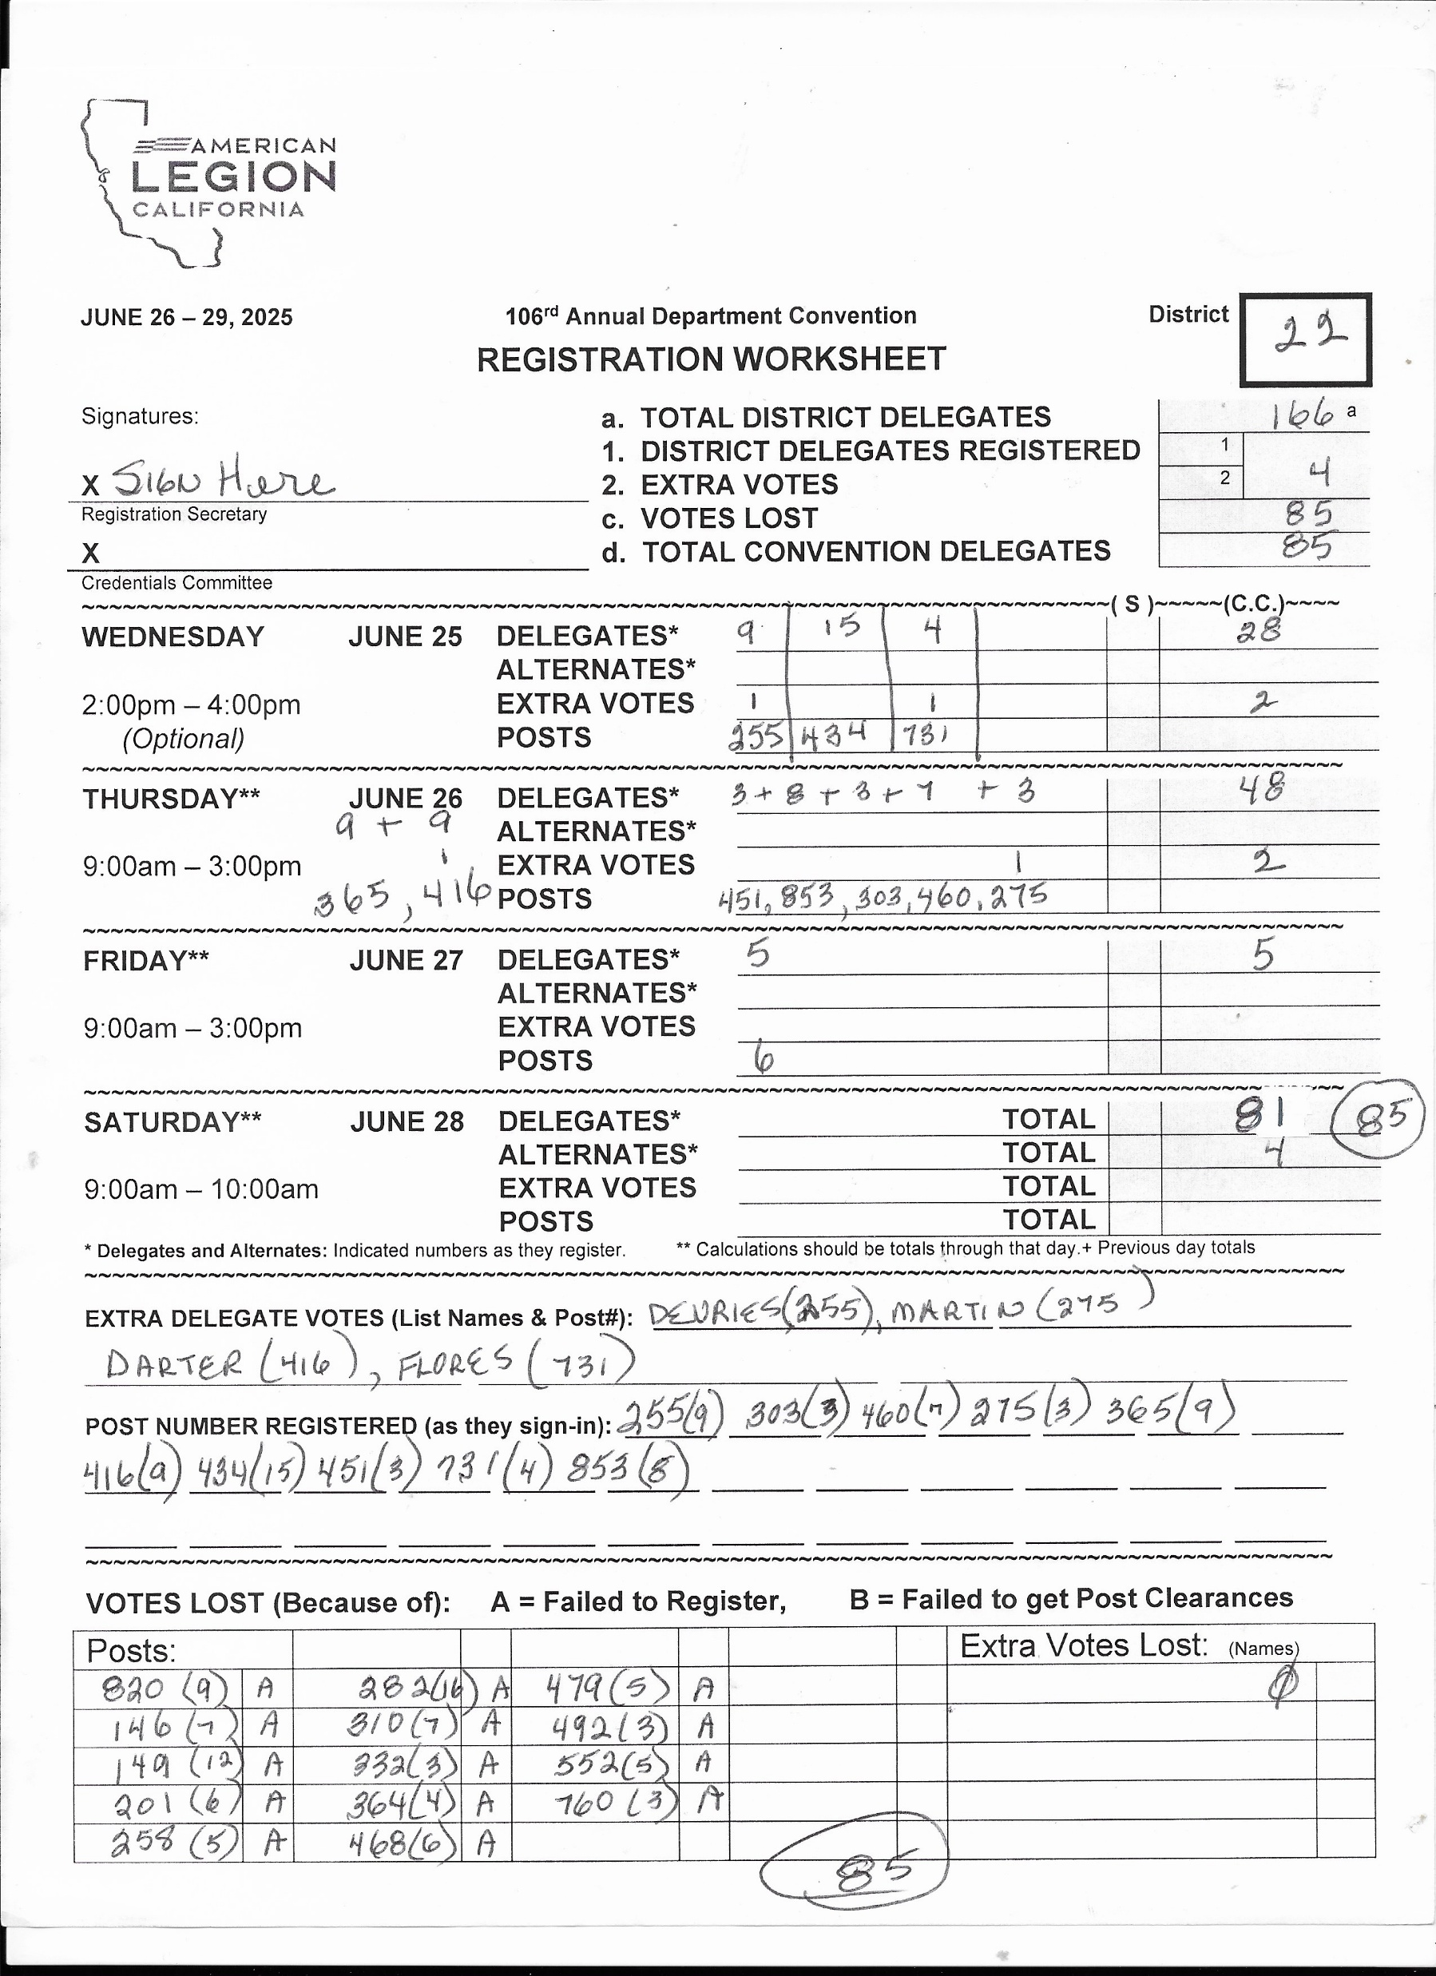

Slide 11
SPECIAL RULE FOR
DELEGATES-IN THEIR OWN RIGHT
Uniform Code of Procedures for the Operation of Department Convention (DELEGATES/FEES, Section 5)
  All past Department Commanders, past Department Adjutants, members of the Department Executive Committee and all incumbent elected Department officers who attend and register as such, shall be delegates to the Department Convention with voice and vote. (Delegate in their own right)
Uniform Code of Procedures for the Operation of Department Convention
(DELEGATES/FEES, Section 13)
    Such persons shall not be empowered to qualify their post delegation for attendance unless they are a duly accredited delegate of their post.

Slide 12
Registration Folder
Administrative Compliance Report provided
  Check to see if Post has completed all requirements
Certification of Delegates submitted by each Post
  Only Posts that have submitted all requirements will be attached
  Locate delegate sheet from that Post
  Have delegate initial beside name
Issue a lanyard and delegate/alternate ribbon

Slide 14
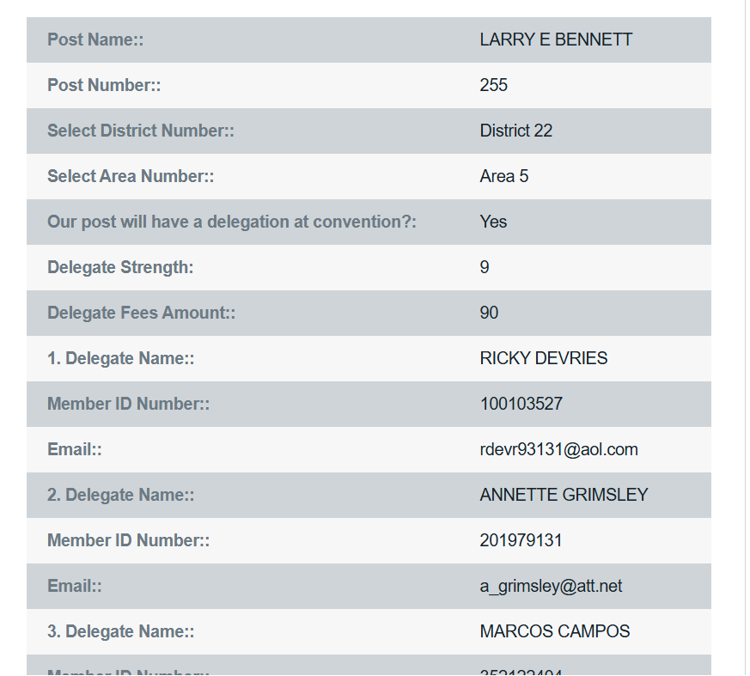

Slide 15
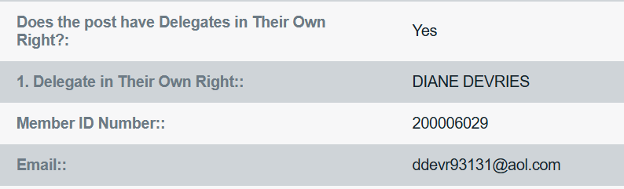

Slide 16
Registration Folder
Registration worksheet
  Updated daily
  List Posts and Extra Delegates (in their own right) as they check in
  At the end of each day calculate Delegates, Alternates, Extra Votes and Posts using Delegate Strength Report
No later than 10 am Saturday, June 27, 2026
  Finish bottom of worksheet
  Total delegates at top of sheet
Sign worksheet and turn folder into HQ

Slide 17
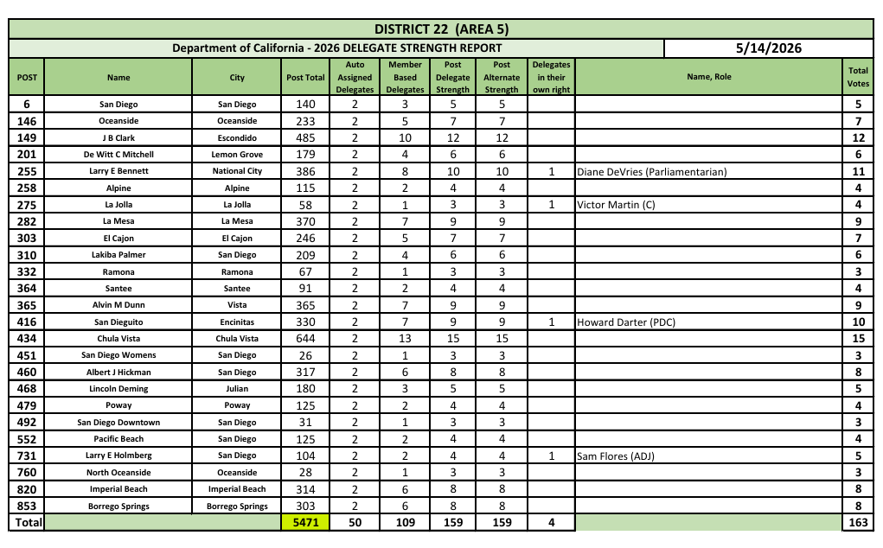

Slide 18
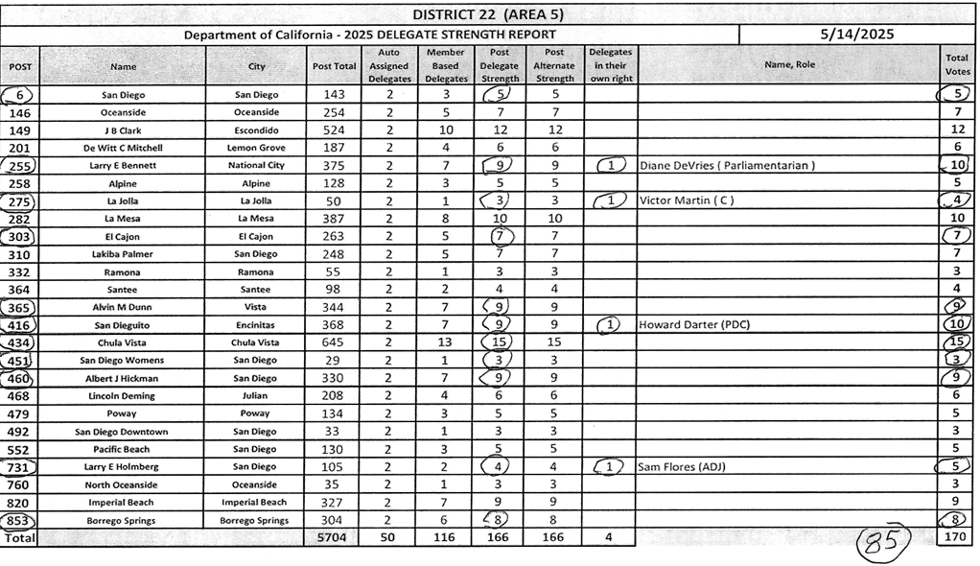

Slide 19
Posts not in Compliance
STUFF HAPPENS
Up until Saturday, June 27 at 10 am Posts have a chance to submit delinquent reports
Contact their Post for a copy of a delinquent report
Submit hand-carried reports
Submit report (calegion.org)
Up until Friday, June 26 at close of business pay delegate fees (cash, check, electronic to Crystal)
HQ Staff & Credentials Committee are here to help
Post will receive a Convention Post Clearance form from HQ and can then be checked in
Post Clearance form is to be placed on right side of folder

Slide 20
2025
Convention Post Clearances
Post # | CByLaws | Audits | Officers | Delegates | CPR | Balance Due
Post # | CByLaws | Audits | Officers | Delegates | CPR | Balance Due Dept
Post # | CByLaws | Audits | Officers | Delegates | CPR | Balance Due Dept
Post # | CByLaws | Audits | Officers | Delegates | CPR | Balance Due Dept
Post # | CByLaws | Audits | Officers | Delegates | CPR | Balance Due
2025
Convention Post Clearances
_ _ _ _ _ _ _ _ _ _ _ _ _ _ _ _ _ _ _ _ _ _ _ _ _ _ _ _ _ _ _ _ _ _ _ _ _ _ _ _ _ _ _ _ _ _ _ _ _ _ _ _ _ _ _ _ _ _ _ _ _ _ _ _ _ _
2025
Convention Post Clearances
_ _ _ _ _ _ _ _ _ _ _ _ _ _ _ _ _ _ _ _ _ _ _ _ _ _ _ _ _ _ _ _ _ _ _ _ _ _ _ _ _ _ _ _ _ _ _ _ _ _ _ _ _ _ _ _ _ _ _ _ _ _ _ _ _ _
2025
Convention Post Clearances
_ _ _ _ _ _ _ _ _ _ _ _ _ _ _ _ _ _ _ _ _ _ _ _ _ _ _ _ _ _ _ _ _ _ _ _ _ _ _ _ _ _ _ _ _ _ _ _ _ _ _ _ _ _ _ _ _ _ _ _ _ _ _ _ _ _
2025
Convention Post Clearances

Slide 21
CREDENTIALS COMMITTEE
Diane DeVries
Dana Davies (chair)
Rick DeVries
Michelle Heaton
HQ Staff

Slide 22
DISTRICT SECRETARIES
District folders and unused delegate badges will be turned into HQ at the end of each day (Thursday and Friday) and no later than 10 am on Saturday
On Saturday at 10 am the HQ Office will close for registration purposes
District Secretary checks may be picked up at HQ Office anytime after 9 am on Sunday
Only the District Secretary who was on the roster may pick up their check

Slide 23
TRAINING
Thursday, June 11 at 6 pm via ZOOM
Wednesday, June 17 at 6 pm via ZOOM
Monday, June 22 at 6 pm (UPDATE: 7 pm) via ZOOM
The meeting link will be sent to all District Secretaries & Credential Committee

Slide 24
QUESTIONS
?

